Slide 1

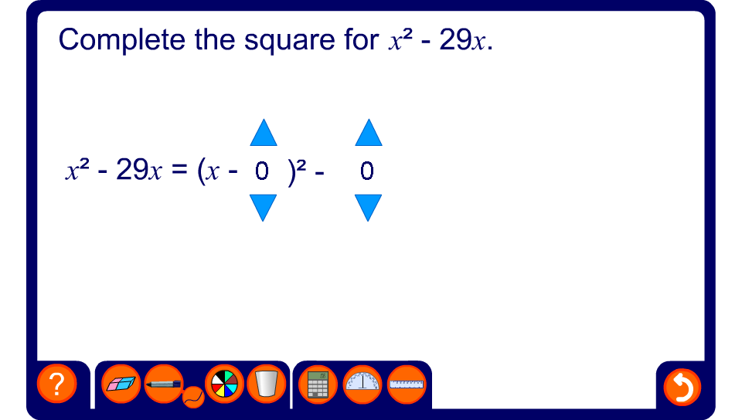


Expressions in the form x² + bx

